Slide 1
Clearing the Shopping Cart

Slide 2
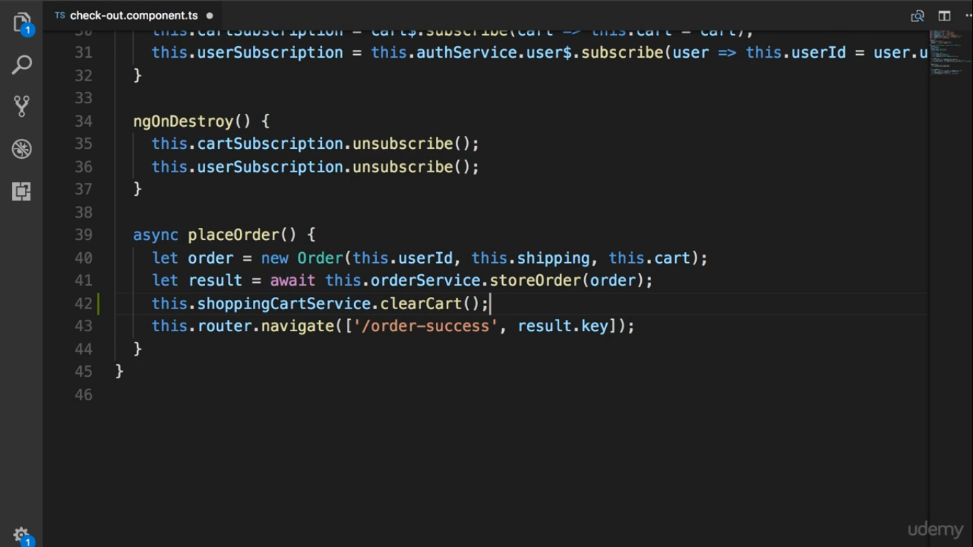

Slide 3
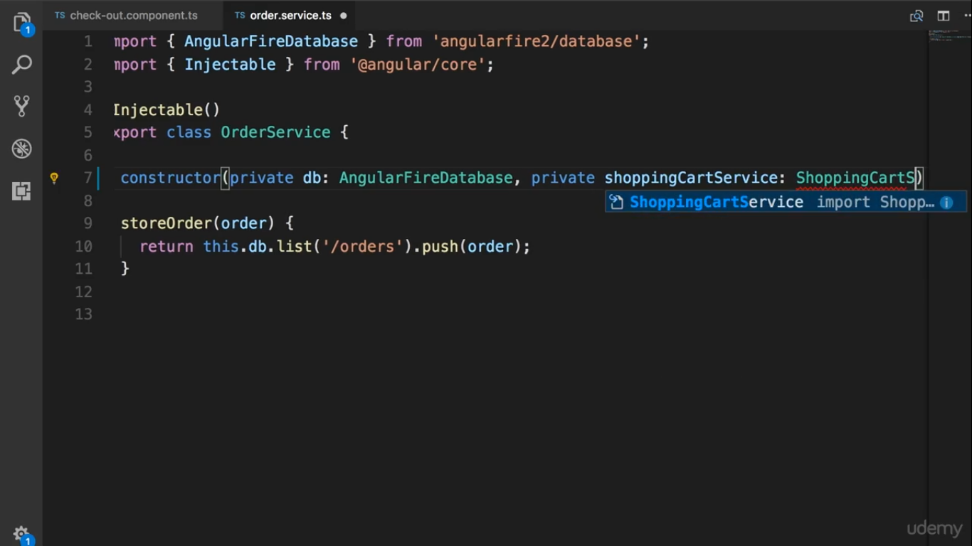

Slide 4
